Slide 1



STRESS MANAGEMENT

Slide 2
The Nature of Stress
Stress Defined
  A person’s adaptive response to a stimulus that places excessive psychological or physical demands on that person
The Stress Process (Selye)
Selye – “Father of Stress” defined stress as “the non-specific response of the human body to any demand made on it”
  General Adaptation Syndrome
    Identifies three stages of response to a stressor: alarm, resistance, exhaustion
    Sources of stress:
      Eustress: pleasurable stress accompanying positive events
      Distress: unpleasant stress accompanying negative events

Slide 3
WHAT IS STRESS ?
Stress is the “wear and tear” our minds and bodies experience as we attempt to cope with our continually changing environment

Slide 4
General Adaptation Syndrome
  Several physiological adaptations occur as a result of repeated stress and these changes are so subtle at times that they are unnoticed till a permanent damage has occurred.
  Selye referred to these changes as the General Adaptation Syndrome, a process by which body tries to accommodate stress by adapting to it.
  Three stages of General Adaptation Syndrome
  Alarm: preparation of body for fight or flight
  Resistance: maintain state of elevated preparation as the perception of threat still exists
  Exhaustion: when demands exceed body’s capabilities
  His research has been instrumental in opening the door to understanding relationship between stress and disease

Slide 5
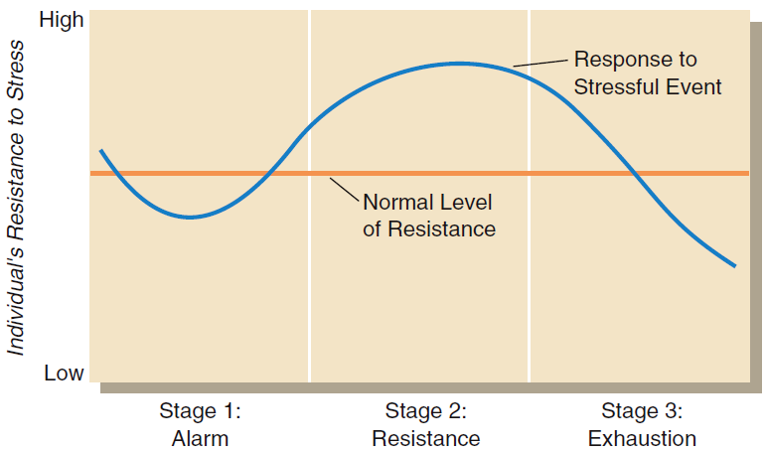
General Adaptation Syndrome

Slide 6
Individual Differences and Stress
Type A Personality Profile
  Extremely competitive, highly committed to work, have a strong sense of time urgency
Type B Personality Profile
  Less competitive, less committed to work, have a weaker sense of time urgency
Hardiness
  A person’s ability to cope with stress
Optimism
  The extent to which a person sees life in relatively positive or negative terms

Slide 7
What is a Stressor?
Stressors
  Physical or psychological demands to which an individual responds
Strains
  Reaction or response to stressors
Situational constraints
Heat, cold, noise
Role stressors
Interpersonal conflict
Emotional labor
Work schedule
Workload
Perceived control
Work pace, time pressure

Slide 8
Causes and Consequences of Stress
Most Common Causes of Stress
  Organizational stressors
  Life stressors
Most Common Consequences of Stress
  Individual consequences
  Organizational consequences
  Burnout

Slide 9
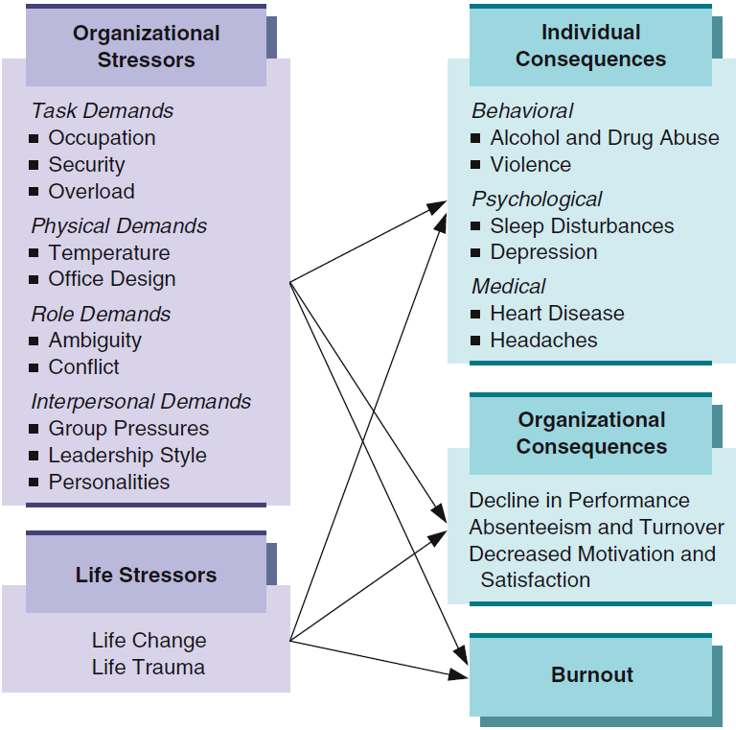
Causes and
Consequences
of Stress

Slide 10
Organizational Stressors: The Workplace
Workplace Stress Factors
  Task Demands
    Associated with the specific job a person performs
  Physical Demands
    Associated with the job’s physical setting and requirements
  Role Demands
    Associated with the expected behaviors of a particular position in a group or organization
  Interpersonal Demands
    Group pressures, leadership, personality conflicts

Slide 11
Organizational Stressors: Role Demands
Role
  A set of expected behaviors associated with a particular position in a group or organization.
Role Stress
  Role ambiguity due to unclear roles
  Role conflict due to:
    Interrole conflict
    Intrarole conflict
    Intersender conflict
  Role overload due to role expectations exceeding an individual’s capabilities

Slide 12
External Causes of Stress
Life Stressors
  Events that take place outside the organization
    Life change
      Any meaningful change in a person’s personal or work situation
    Life trauma
      Any upheaval in an individual’s life that alters his or her attitudes, emotions or behaviors

Slide 13


Most and Least Stressful Jobs
Top Most Stressful Jobs | Top Least Stressful Jobs
1. Surgeon | 1. Actuary
2. Commercial airline pilot | 2. Dietitian
3. Photojournalist | 3. Computer systems analyst
4. Advertising account executive | 4. Statistician
5. Real estate agent | 5. Astronomer
6. Physician (general practice) | 6. Mathematician
7. Reporter (newspaper) | 7. Historian
8. Physician Assistant | 8. Software engineer

Slide 14
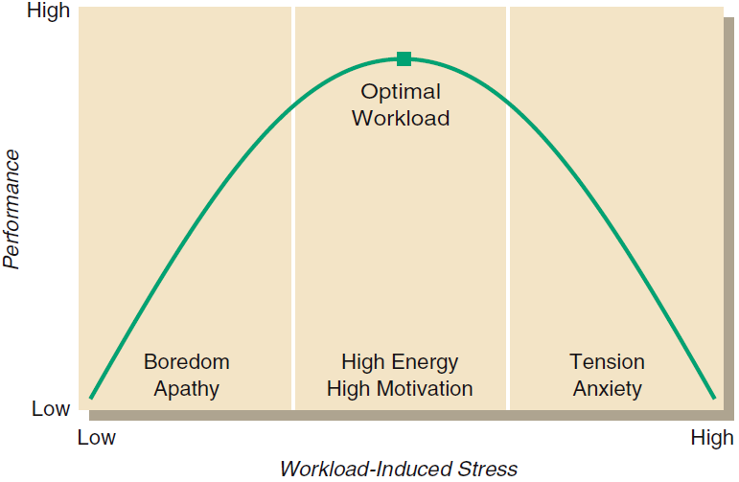
Workload, Stress, and Performance

Slide 15
A + B = C Model
A-B-C Model of Stress and Anxiety
A- Activating Events- Stressors
Everyday events, Normal Stressors
Panic causing events / phobias
B- Beliefs, Worries and Fears
Beliefs: “I have to be the best at everything I do to be good at all.”
Worries: “If I don’t get a ____ on my SATs I won’t get into an Ivy.”
Fears: “I won’t be able to get to a hospital in time and will die driving.”
C- Consequences
Emotional- Stress, anxiety
Behavioral- Phobic avoidance, procrastination
Physiological- muscle tension, ↑heart rate, changes in blood pressure

Slide 16
Demand-Control Model
  Two factors prominent in producing job stress
    Job demands
      Workload or intellectual requirements
    Control (decision latitude)
      Autonomy & discretion for using different skills

Slide 17
Demand-Control Model
Karasek's High Demand-Low Control Model defines high stress, unhealthy jobs as those with low control and high demand conditions.
Low control conditions include de-skilled labour and reduced decision making autonomy. Employees in this position are not given the leeway to make decisions regarding their work or work environment. They also do not have the opportunity to learn new skills on the job or problem solve.
High demand conditions include inadequate time to meet job demands and excessive workload. When asked about their workload, employees in high demand situations often say, "I work very fast and/or hard," and, "There is not enough time to get the job done."
Karasek defines jobs and their associated stress levels by their particular demand-control combination (Schnall, 1998).

Slide 18
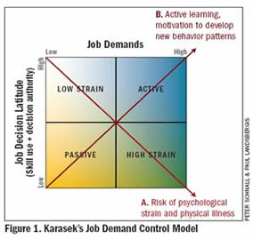

Slide 19
Active: These highly demanding jobs offer employees challenging work in environments of great flexibility and latitude. The ability to constantly learn new skills in an environment that provides the leeway to problem solve enables these employees to reduce levels of stress and maintain high levels of health. Example jobs include engineer, physician, and teacher
High Strain: These jobs are defined by low decision making latitude, and high physical and/or psychological demands. The workplace is often rigid and inflexible in both environment and policy, thus workers are unable to take actions in order to control their environment and cope with the stress. As expected, these jobs lead to high levels of mental and physical illness among employees. Example jobs include waitress, nurses aid
Low Strain: These jobs are defined by few psychological demands and a high level of control in the workplace. As expected, workers have higher than average levels of health and happiness. Example jobs include natural scientist, lineman, and architect.
Passive: These jobs are defined by low decision making latitude, and low work demand. It often includes irrelevant, unchallenging, and unskilled work that is unsatisfying for the employee leading to apathy and boredom. These jobs also lead to high levels of mental and physical illness among employees. Example jobs include janitor, miner, and watchman.

Slide 20
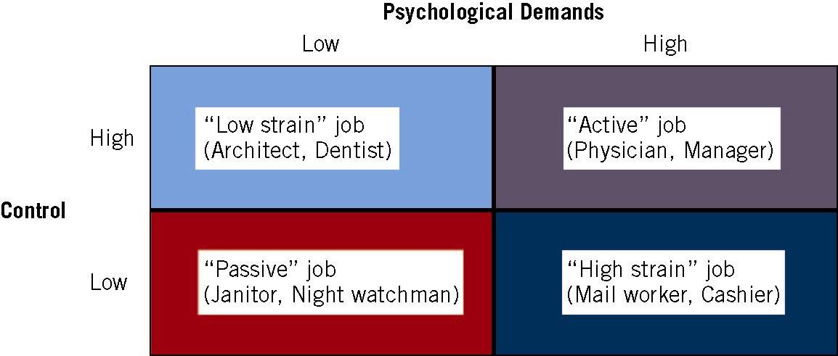
Demand-Control Model
Notes:
Demand-Control Model
Source: Adapted from Karasek (1979).

Slide 21
Consequences of Stress
Individual Consequences
  Behavioral
  negative effects on memory, reaction time, accuracy, & task performance
  Psychological
  Burnout
  over activation of sympathetic nervous system (SNS), producing several kinds of stress hormones
Organizational Consequences
  Performance
  Withdrawal
  Attitudes
  Burnout
Notes:
Burnout- Extreme state of psychological strain resulting from prolonged response to chronic job stressors that exceed an individual’s resources to cope with them
Chronic activation of SNS leads to “wear & tear” on coronary arteries & heart

Slide 22
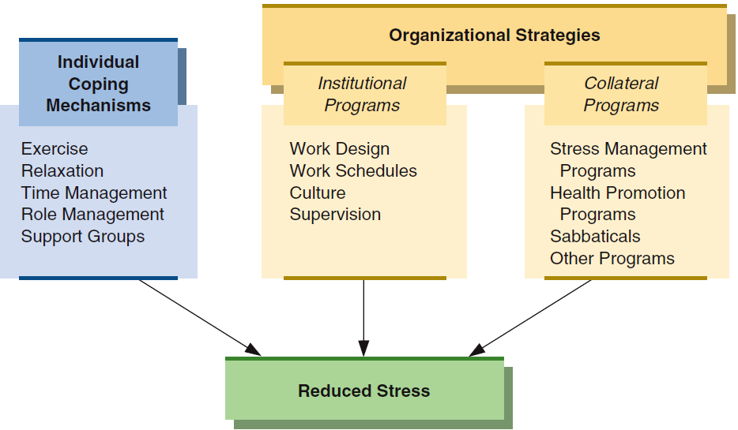
Individual and Organizational Coping Strategies

Slide 23

The Key Word Is….
Balance

